Slide 1


Three Sons and a Bundle of Sticks
You could easily break the single sticks into pieces, but you were not able to break the bundle : Moral: Unity is Strength

Slide 2
Divide-and-Conquer
Divide-and-conquer method for algorithm design:
Divide: If the input size is too large to deal with in a straightforward manner, divide the problem into two or more disjoint sub problems
Conquer: recursively to solve the sub problems
Combine: Take the solutions to the sub problems and “merge” these solutions into a solution for the original problem

Slide 3
Merge sort

Slide 4
How we merge two sorted arrays ?
14
23
45
98
6
33
42
67

Slide 5
14
23
45
98
6
33
42
67
Merge

Slide 6
14
23
45
98
6
33
42
67
6
Merge

Slide 7
14
23
45
98
6
33
42
67
6
14
Merge

Slide 8
14
23
45
98
6
33
42
67
6
14
23
Merge

Slide 9
14
23
45
98
6
33
42
67
6
14
23
33
Merge

Slide 10
14
23
45
98
6
33
42
67
6
14
23
33
42
Merge

Slide 11
14
23
45
98
6
33
42
67
6
14
23
33
42
45
Merge

Slide 12
14
23
45
98
6
33
42
67
6
14
23
33
42
45
67
Merge

Slide 13
14
23
45
98
6
33
42
67
6
14
23
33
42
45
67
98
Merge

Slide 14
void merge(int a[],int lo, int m, int hi) { int i, j, k; for (i=lo; i<=hi; i++) b[i]=a[i]; // copy both halves of a to auxiliary array b end for i=lo; j=m+1; k=lo; while (i<=m && j<=hi) if (b[i]<=b[j]) a[k++]=b[i++]; // merge the two arrays else a[k++]=b[j++]; End while while (i<=m) a[k++]=b[i++]; // remaining elements of first half while (j<=hi) a[k++]=b[j++]; //remaining elements of second half }

Slide 15
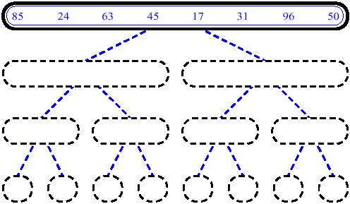
Merge Sort

Slide 16
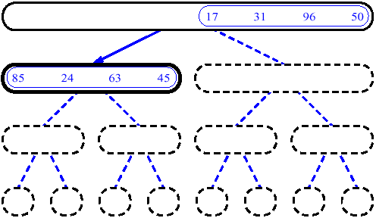
Merge Sort

Slide 17
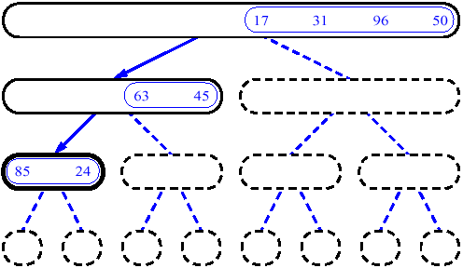
Merge Sort

Slide 18
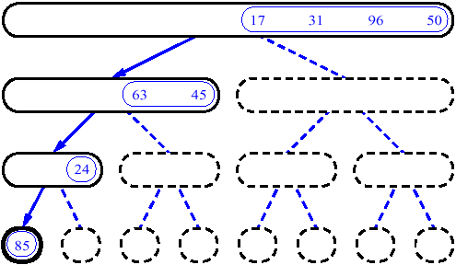
Merge Sort

Slide 19
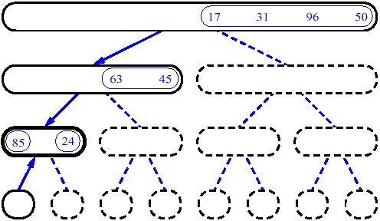
Merge Sort

Slide 20
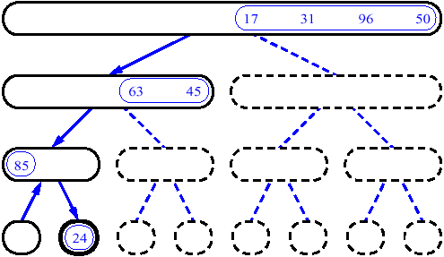
Merge Sort

Slide 21
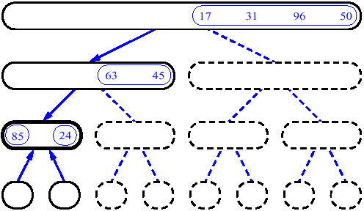
Merge Sort

Slide 22
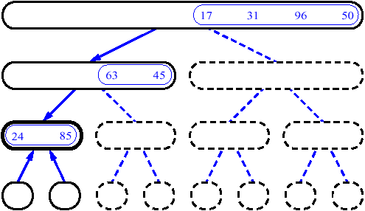
Merge Sort

Slide 23
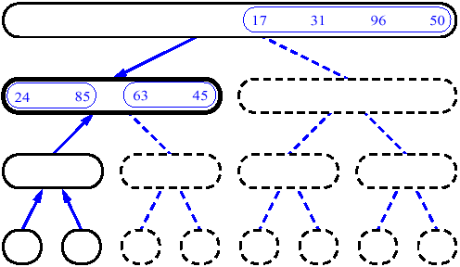
Merge Sort

Slide 24
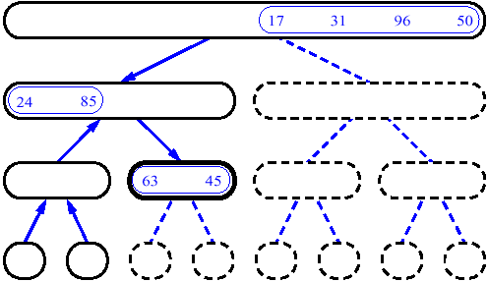
Merge Sort

Slide 25
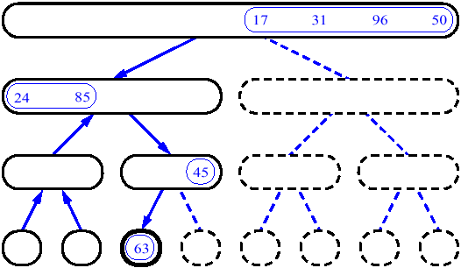
Merge Sort

Slide 26
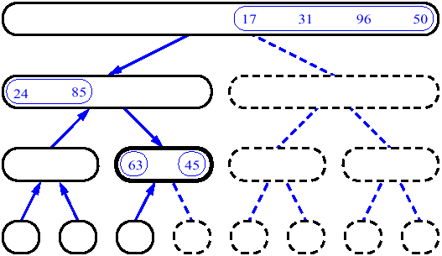
Merge Sort

Slide 27
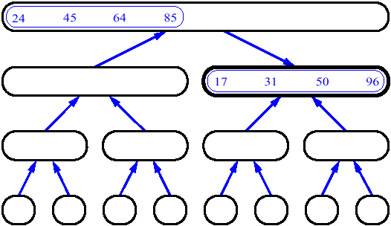
Merge Sort

Slide 28
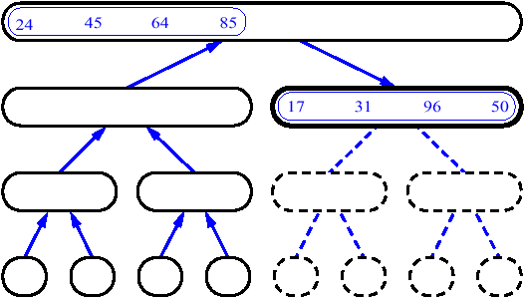
Merge Sort

Slide 29
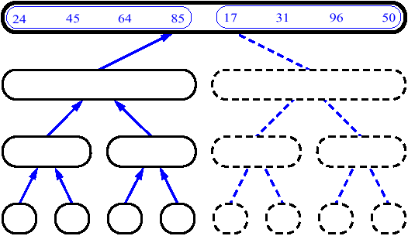
Merge Sort

Slide 30
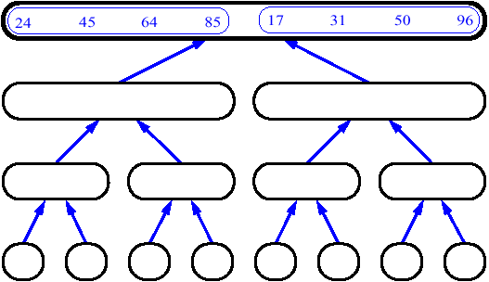
Merge Sort

Slide 31
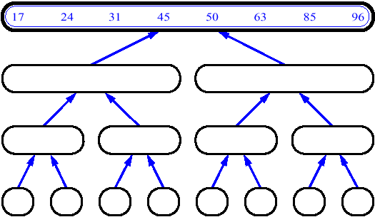
Merge Sort

Slide 32
Merge Sort Algorithm
void merge sort(int a[],int lo, int hi)
{ if (lo<hi)
{ int m=(lo+hi)/2;
merge sort(a[],lo, m);
merge sort(a[],m+1, hi);
merge(a[], lo, m, hi);
}
}
Time complexity of merge sort is O(logn)
Time complexity of merge is O(n)

Slide 33
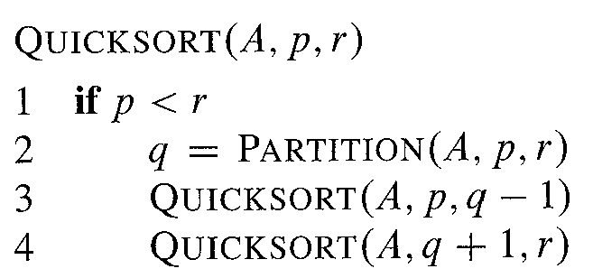
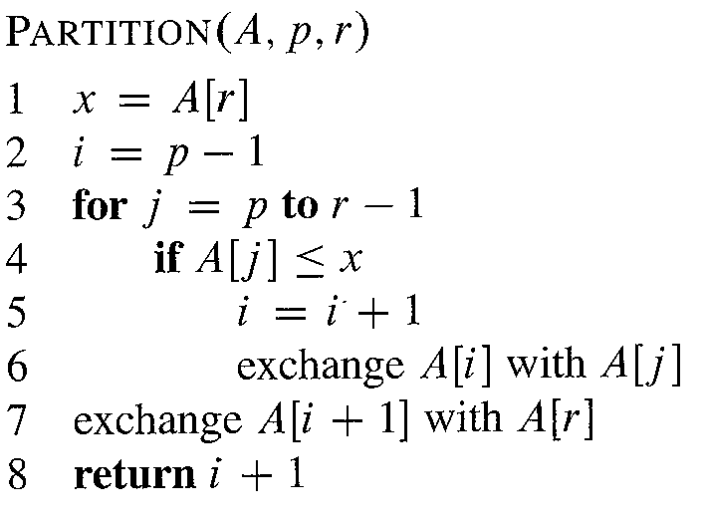
Quick Sort
The Pseudo-Code

Slide 34
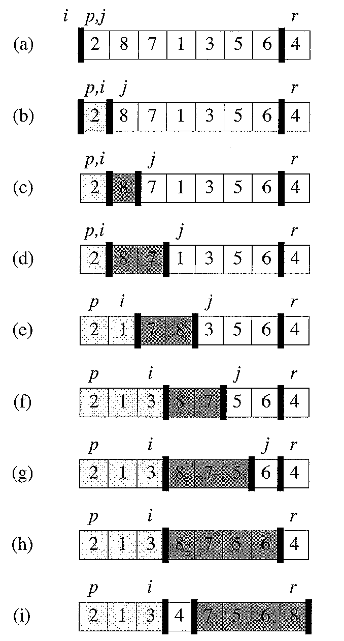
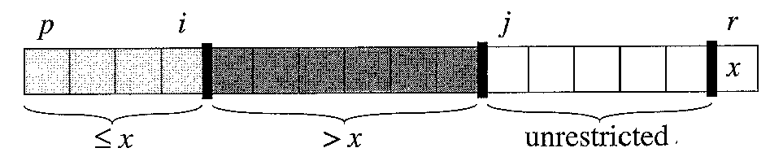
Quick Sort

Slide 35
Analysis of Quick sort
The running time of quicksort depends on whether the partitioning is balanced or unbalanced, and this in turn depends on which elements are used for partitioning.
If the partitioning is balanced, the algorithm runs asymptotically as fast as mergesort.
If the partitioning is unbalanced, however, it can run asymptotically as slowly as insertion sort.

Slide 36
Worst case partitioning

Slide 37
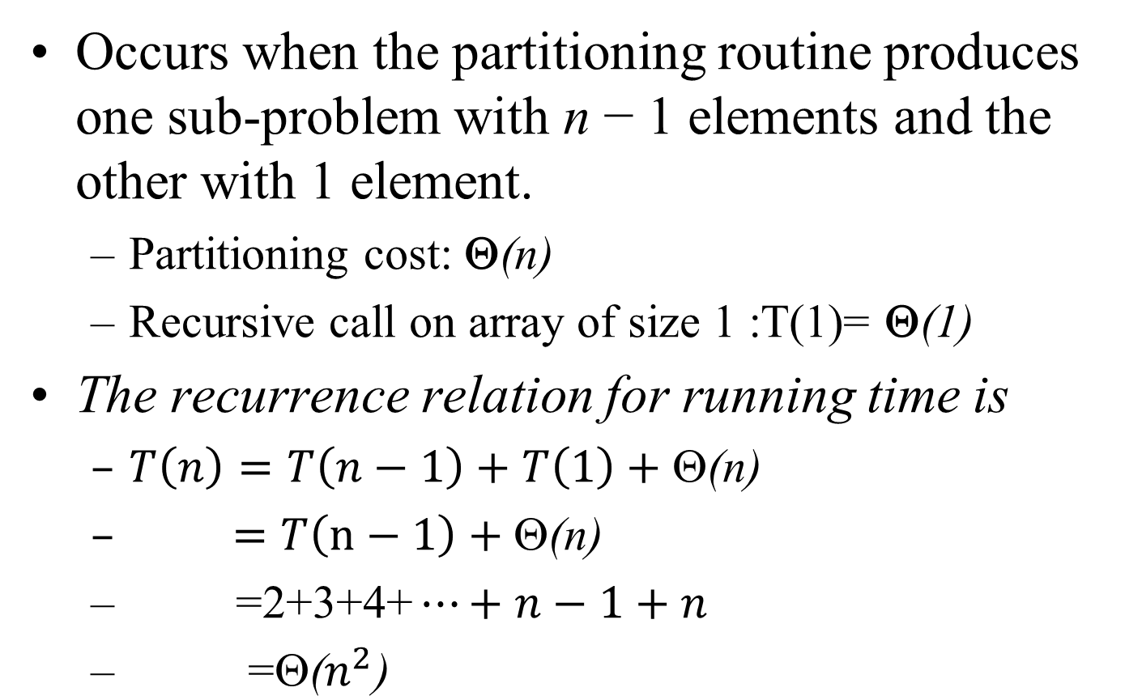
Worst case partitioning
Occurs when the partitioning routine produces one sub-problem with n − 1 elements and the other with 1 element.
Partitioning cost: Θ(n)
Recursive call on array of size 1 :T(1)= Θ(1)
The recurrence relation for running time is
$T\left(n\right)=T\left(n−1\right)+T\left(1\right)+\text{Θ}\text{(}\text{n}\text{)}$
$=T\left(n−1\right)+\text{Θ}\text{(}\text{n}\text{)}$
$\text{=2+3+4+}…+n−1+n$
$\text{=}\text{Θ}\text{(}n^{2}\text{)}$

Slide 38
Best case partitioning

Slide 39
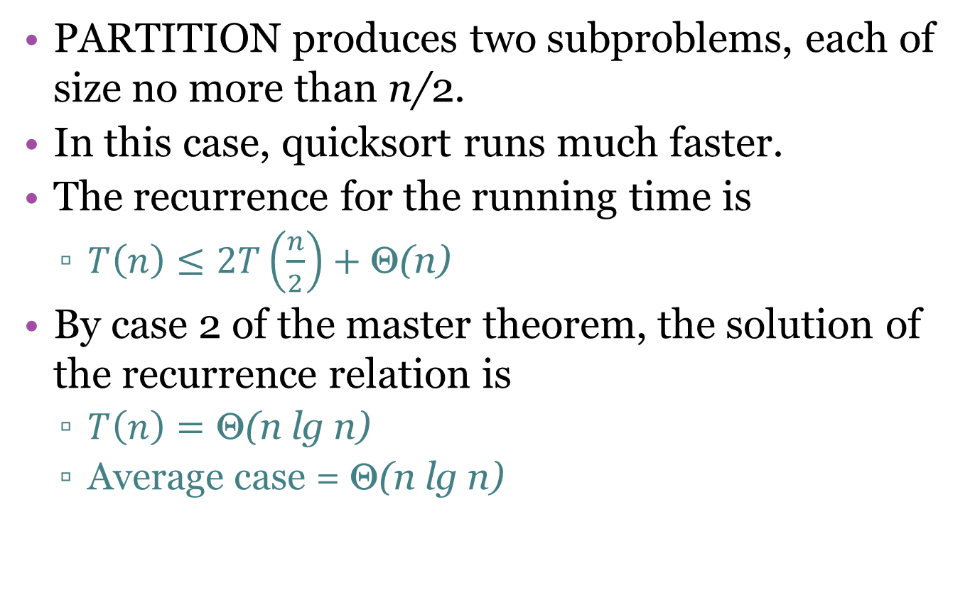
Best case partitioning
PARTITION produces two subproblems, each of size no more than n/2.
In this case, quicksort runs much faster.
The recurrence for the running time is
$T\left(n\right)≤2T\left(\frac{n}{2}\right)+\text{Θ}\text{(}\text{n}\text{)}$
By case 2 of the master theorem, the solution of the recurrence relation is
$T\left(n\right)=\text{Θ}\text{(}\text{n} \text{lg} \text{n}\text{)}$
Average case = $\text{}\text{(}\text{n} \text{lg} \text{n}\text{)}$

Slide 40
Picking a better pivot
Before, we picked the first element of the subarray to use as a pivot
If the array is already sorted, this results in O(n²) behavior
It’s no better if we pick the last element
We could do an optimal quick sort (guaranteed O(n log n)) if we always picked a pivot value that exactly cuts the array in half

